Slide 1
Going Further
From regression to classification
Laurence Moroney, Google

Slide 2
X
Y

Slide 3
X
Y

Slide 4
X
Y

Slide 5
Notes:
Pictures all generated using Google Docs scribble tool

Slide 6
1
0
Notes:
Pictures all generated using Google Docs scribble tool

Slide 7
1
0
Notes:
Pictures all generated using Google Docs scribble tool

Slide 8
1
0
Notes:
Pictures all generated using Google Docs scribble tool

Slide 9
Data
Label
[ 1, 0 ]
[ 0, 1 ]
Notes:
Pictures all generated using Google Docs scribble tool

Slide 10
0
1
2
3
4
5
6
7
8
9
[ 1, 0, 0, 0, 0, 0, 0, 0, 0, 0 ]
[ 0, 1, 0, 0, 0, 0, 0, 0, 0, 0 ]
[ 0, 0, 1, 0, 0, 0, 0, 0, 0, 0 ]
[ 0, 0, 0, 1, 0, 0, 0, 0, 0, 0 ]
[ 0, 0, 0, 0, 1, 0, 0, 0, 0, 0 ]
[ 0, 0, 0, 0, 0, 1, 0, 0, 0, 0 ]
[ 0, 0, 0, 0, 0, 0, 1, 0, 0, 0 ]
[ 0, 0, 0, 0, 0, 0, 0, 1, 0, 0 ]
[ 0, 0, 0, 0, 0, 0, 0, 0, 1, 0 ]
[ 0, 0, 0, 0, 0, 0, 0, 0, 0, 1 ]
Notes:
Pictures all generated using Google Docs scribble tool

Slide 11
import tensorflow as tf
data = tf.keras.datasets.mnist
(training_images, training_labels), (val_images, val_labels) = data.load_data()
training_images = training_images / 255.0
val_images = val_images / 255.0
model = tf.keras.models.Sequential(
[tf.keras.layers.Flatten(input_shape=(28,28)),
tf.keras.layers.Dense(20, activation=tf.nn.relu),
tf.keras.layers.Dense(10, activation=tf.nn.softmax)])

Slide 12
import tensorflow as tf
data = tf.keras.datasets.mnist
(training_images, training_labels), (val_images, val_labels) = data.load_data()
training_images = training_images / 255.0
val_images = val_images / 255.0
model = tf.keras.models.Sequential(
[tf.keras.layers.Flatten(input_shape=(28,28)),
tf.keras.layers.Dense(20, activation=tf.nn.relu),
tf.keras.layers.Dense(10, activation=tf.nn.softmax)])

Slide 13
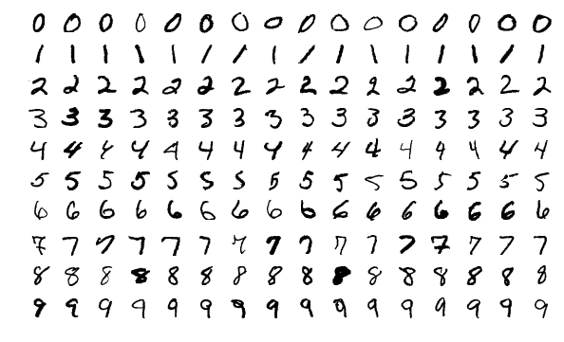
60,000 Labelled Training Examples
10.000 Labelled Validation Examples
Notes:
Image from: https://en.wikipedia.org/wiki/MNIST_database#/media/File:MnistExamples.png

Slide 14
import tensorflow as tf
data = tf.keras.datasets.mnist
(training_images, training_labels), (val_images, val_labels) = data.load_data()
training_images = training_images / 255.0
val_images = val_images / 255.0
model = tf.keras.models.Sequential(
[tf.keras.layers.Flatten(input_shape=(28,28)),
tf.keras.layers.Dense(20, activation=tf.nn.relu),
tf.keras.layers.Dense(10, activation=tf.nn.softmax)])

Slide 15
import tensorflow as tf
data = tf.keras.datasets.mnist
(training_images, training_labels), (val_images, val_labels) = data.load_data()
training_images = training_images / 255.0
val_images = val_images / 255.0
model = tf.keras.models.Sequential(
[tf.keras.layers.Flatten(input_shape=(28,28)),
tf.keras.layers.Dense(20, activation=tf.nn.relu),
tf.keras.layers.Dense(10, activation=tf.nn.softmax)])

Slide 16
import tensorflow as tf
data = tf.keras.datasets.mnist
(training_images, training_labels), (val_images, val_labels) = data.load_data()
training_images = training_images / 255.0
val_images = val_images / 255.0
model = tf.keras.models.Sequential(
[tf.keras.layers.Flatten(input_shape=(28,28)),
tf.keras.layers.Dense(20, activation=tf.nn.relu),
tf.keras.layers.Dense(10, activation=tf.nn.softmax)])

Slide 17
import tensorflow as tf
data = tf.keras.datasets.mnist
(training_images, training_labels), (val_images, val_labels) = data.load_data()
training_images = training_images / 255.0
val_images = val_images / 255.0
model = tf.keras.models.Sequential(
[tf.keras.layers.Flatten(input_shape=(28,28)),
tf.keras.layers.Dense(20, activation=tf.nn.relu),
tf.keras.layers.Dense(10, activation=tf.nn.softmax)])

Slide 18
import tensorflow as tf
data = tf.keras.datasets.mnist
(training_images, training_labels), (val_images, val_labels) = data.load_data()
training_images = training_images / 255.0
val_images = val_images / 255.0
model = tf.keras.models.Sequential(
[tf.keras.layers.Flatten(input_shape=(28,28)),
tf.keras.layers.Dense(20, activation=tf.nn.relu),
tf.keras.layers.Dense(10, activation=tf.nn.softmax)])

Slide 19
import tensorflow as tf
data = tf.keras.datasets.mnist
(training_images, training_labels), (val_images, val_labels) = data.load_data()
training_images = training_images / 255.0
val_images = val_images / 255.0
model = tf.keras.models.Sequential(
[tf.keras.layers.Flatten(input_shape=(28,28)),
tf.keras.layers.Dense(20, activation=tf.nn.relu),
tf.keras.layers.Dense(10, activation=tf.nn.softmax)])

Slide 20
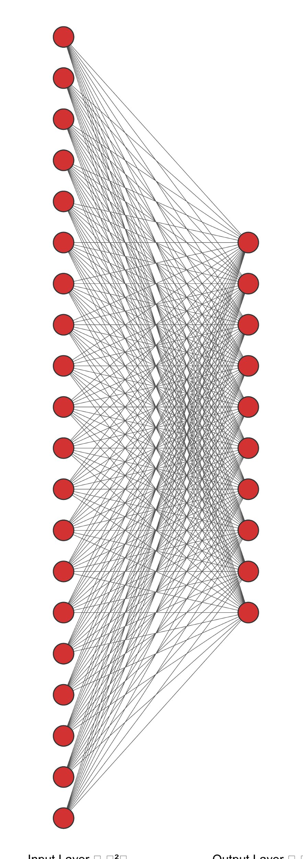
Notes:
Neural net image generated by http://alexlenail.me/NN-SVG/index.html

Slide 21
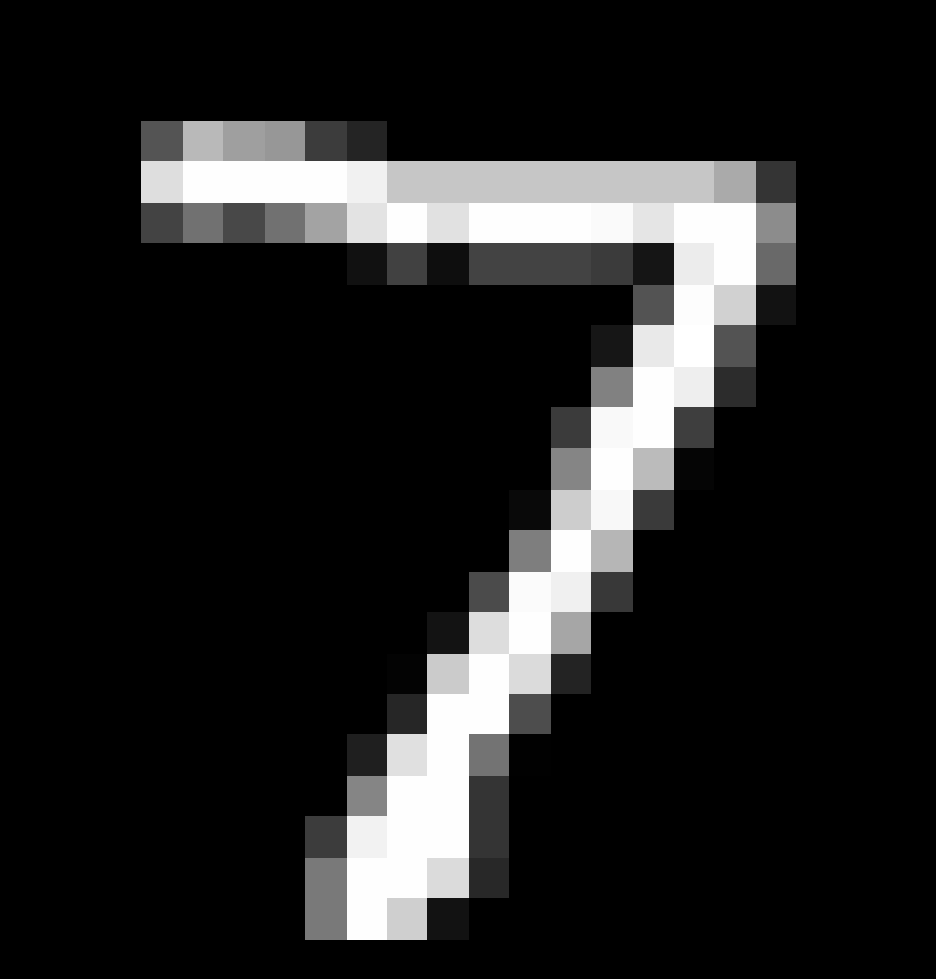
Notes:
7 image from mnist dataset

Slide 22
00
0
0
0
0
0
1
0
0

Slide 23
28px
00
0
0
0
0
0
1
0
0
28px

Slide 24
00
0
0
0
0
0
1
0
0
784

Slide 25
import tensorflow as tf
data = tf.keras.datasets.mnist
(training_images, training_labels), (val_images, val_labels) = data.load_data()
training_images = training_images / 255.0
val_images = val_images / 255.0
model = tf.keras.models.Sequential(
[tf.keras.layers.Flatten(input_shape=(28,28)),
tf.keras.layers.Dense(20, activation=tf.nn.relu),
tf.keras.layers.Dense(10, activation=tf.nn.softmax)])

Slide 26
import tensorflow as tf
data = tf.keras.datasets.mnist
(training_images, training_labels), (val_images, val_labels) = data.load_data()
training_images = training_images / 255.0
val_images = val_images / 255.0
model = tf.keras.models.Sequential(
[tf.keras.layers.Flatten(input_shape=(28,28)),
tf.keras.layers.Dense(20, activation=tf.nn.relu),
tf.keras.layers.Dense(10, activation=tf.nn.softmax)])

Slide 27
import tensorflow as tf
data = tf.keras.datasets.mnist
(training_images, training_labels), (val_images, val_labels) = data.load_data()
training_images = training_images / 255.0
val_images = val_images / 255.0
model = tf.keras.models.Sequential(
[tf.keras.layers.Flatten(input_shape=(28,28)),
tf.keras.layers.Dense(20, activation=tf.nn.relu),
tf.keras.layers.Dense(10, activation=tf.nn.softmax)])

Slide 28
model.compile(optimizer='adam',
loss='sparse_categorical_crossentropy',
metrics=['accuracy'])
model.fit(training_images, training_labels, epochs=20)

Slide 29
model.compile(optimizer='adam',
loss='sparse_categorical_crossentropy',
metrics=['accuracy'])
model.fit(training_images, training_labels, epochs=20)

Slide 30
model.compile(optimizer='adam',
loss='sparse_categorical_crossentropy',
metrics=['accuracy'])
model.fit(training_images, training_labels, epochs=20)

Slide 31
model.compile(optimizer='adam',
loss='sparse_categorical_crossentropy',
metrics=['accuracy'])
model.fit(training_images, training_labels, epochs=20)

Slide 32
classifications = model.predict(val_images)
print(classifications[0])
print(test_labels[0])

Slide 33
classifications = model.predict(val_images)
print(classifications[0])
print(test_labels[0])
[2.4921512e-09 1.3765138e-10 8.8281205e-08 1.0477231e-03 2.8455029e-12 4.0820678e-06 2.0070659e-16 9.9894780e-01 1.0296049e-07 2.9972372e-07]
7

Slide 34
classifications = model.predict(val_images)
print(classifications[0])
print(test_labels[0])
[2.4921512e-09 1.3765138e-10 8.8281205e-08 1.0477231e-03 2.8455029e-12 4.0820678e-06 2.0070659e-16 9.9894780e-01 1.0296049e-07 2.9972372e-07]
7

Slide 35
classifications = model.predict(val_images)
print(classifications[0])
print(test_labels[0])
[2.4921512e-09 1.3765138e-10 8.8281205e-08 1.0477231e-03 2.8455029e-12 4.0820678e-06 2.0070659e-16 9.9894780e-01 1.0296049e-07 2.9972372e-07]
7

Slide 36
Your turn!

Slide 37
784
0 0 0 0 0 0 0 0 0 1

